Slide 1

COSC 2344 Programming Project
Mid-Point Presentation
Project Title: Yalla Riyadh
Name: Anis Mohammad Farooq
Student ID: 1102R11262

Slide 2
Problem Statement and Objectives
Such a system is being developed now because previously the number of tourists visiting Riyadh was a little, but since nowadays the number of tourists is increasing and the ministry of tourism wants to improve tourism and promote Riyadh; the need for such an app is required.
Even though there are different tourism apps for Riyadh, all of them have one thing in common; bad programming and paying attention to details, that’s why until now there isn’t any official app that is sponsored by the ministry of tourism and this app is aiming at eliminating all the negative things the other apps contain and bring out a complete and a beautiful app for tourists who are visiting Riyadh.

Slide 3
Problem Objectives
The objectives of the project are as follows:
To build an app which helps in promoting Riyadh.
To build an app which provides easy information and eases traveling in Riyadh for tourists.
Promote upcoming events and happenings in Riyadh.

Slide 4
Academic Research
Languages Used:
HTML5
CSS
PHP
jQuery
JavaScript

Slide 5
Secondary Research
The system that is to be implemented is categorized as a tourism application for mobile.
There are not so many tourism applications for mobile about Riyadh that can be found online.
Most of the apps found are most likely to have the same functionalities hence; this will be discussed deeper on the similarities and comparisons.
The apps that will be discussed and compared are:
Riyadh Travel Guide
Riyadh City Guide

Slide 6
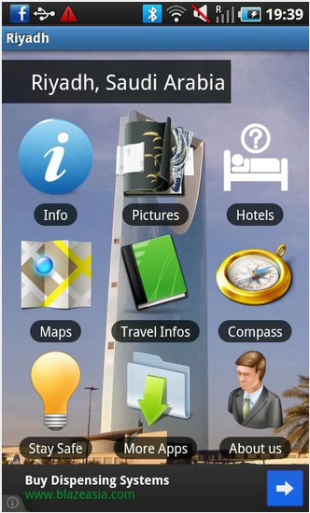
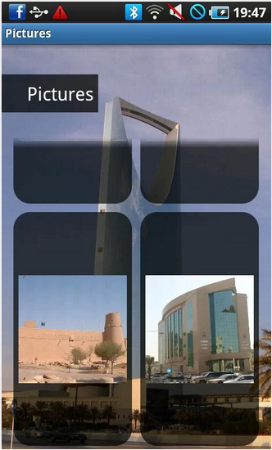
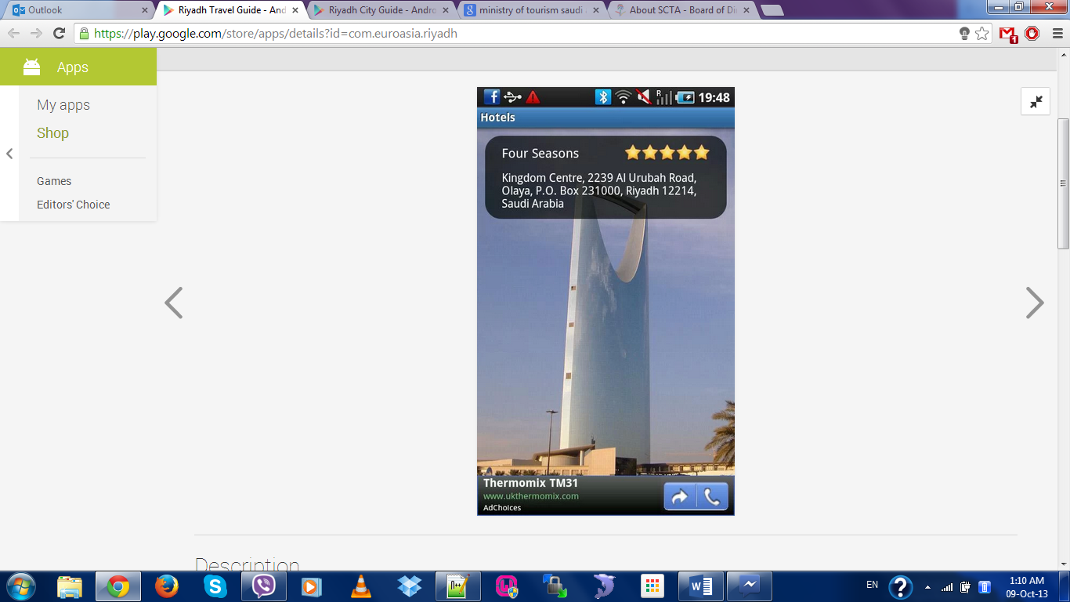
Secondary Research

Slide 7
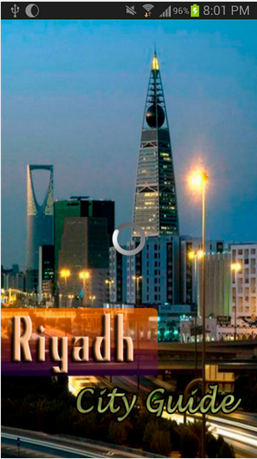
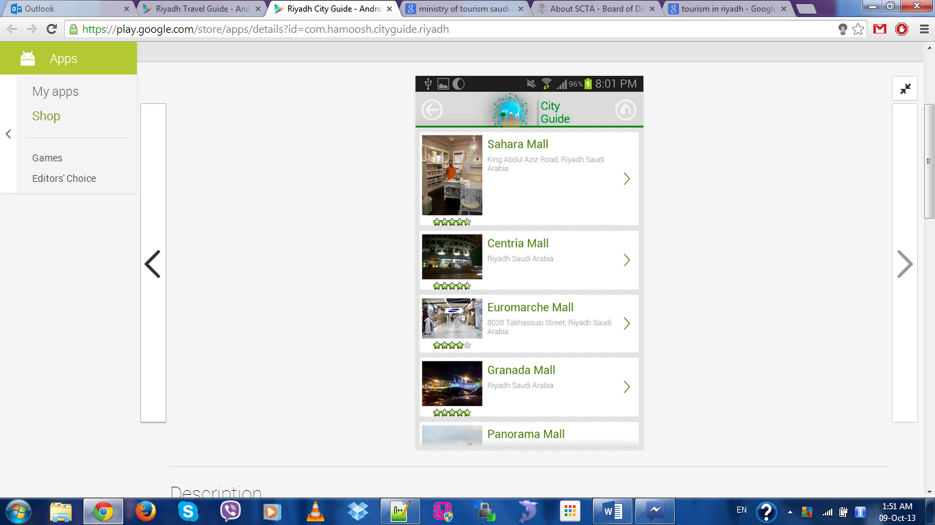
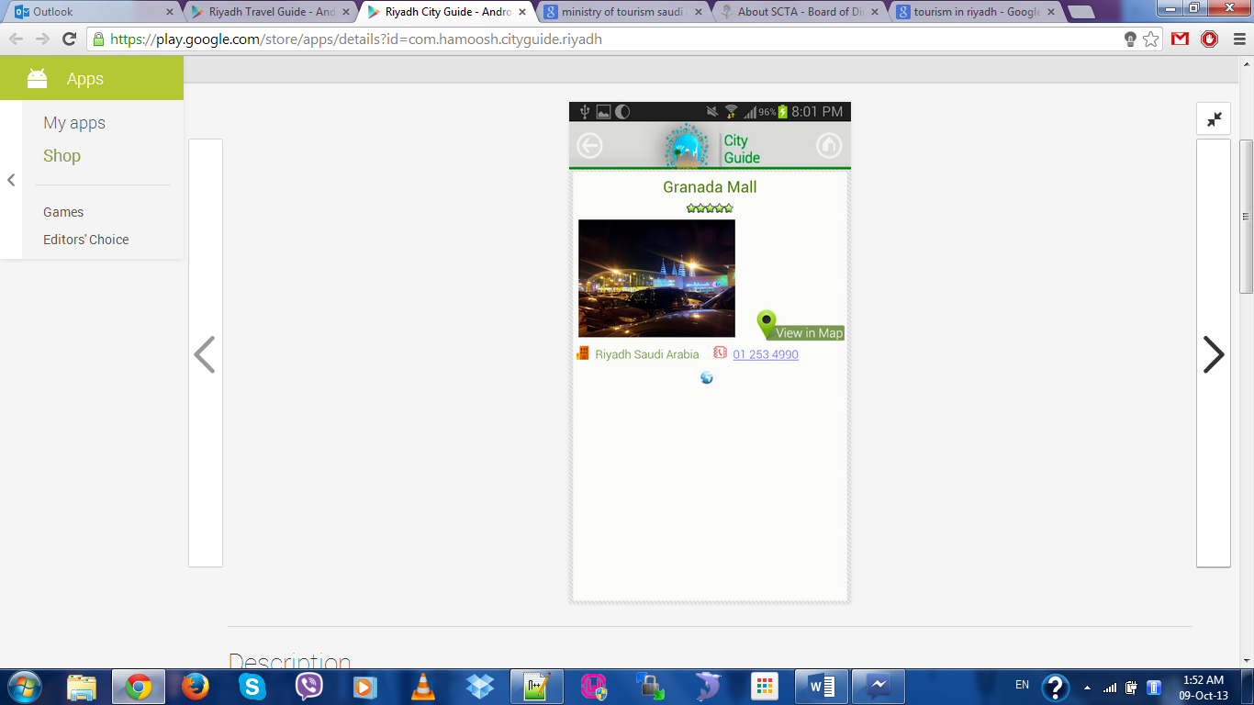
Secondary Research

Slide 8
Primary Research
Rationale:
Before the starting of the project, the developer had an interview session over Skype with the project support of Taiba Tourism.
The purpose of conducting this interview is to gather requirements needed for developing the mobile app.
Suggestions and feedbacks were given by the client on the ideas suggested to be built for the app.
The interview held intends to understand clearly what the client wants in the app in order to avoid any doubt and ambiguities between developer and client.
Notes:
Questionnaire or Interview (or both)

Slide 9
Primary Research
Interview:
Interview session over Skype was held in the very beginning of the stage of developing the project. The person interviewed is the project support of Taiba Tourism by the name of Eng. Abdul Aziz bin Abdullah Al Nasr.
Notes:
Questionnaire or Interview (or both)

Slide 10
Systems Analysis
After the interview session with the representative of Taiba Tourism, an analysis has been made.
The Developer is expected to prepare a mobile app allowing the tourists and residents of Riyadh to download the app on their smartphones and browse through the application.
In addition, there will be an admin view of the app to cater for management purposes.
Admin page will consist of:
Ability to manage and update the mobile app with new attractions and places.
Ability to update the events page to cater for all the new events and happenings.

Slide 11
Requirements Specification

Slide 12
Prototype Demonstration

